Slide 1

Edgecore Networks
Open Wi-Fi Specifications and Design Contributions
ECW5211, ECW7212, ECW7220, ECWO7220

Slide 2
Overview
Edgecore Networks is contributing the design specifications and entire design packages to Open Compute
Seeking “OCP Accepted” status for each product and each specification
Four different designs and packages
ECW5211 – Indoor open Wi-FI Access Point based on Qualcomm
ECW7212 – Indoor open Wi-FI Access Point based on Broadcom
ECW7220 – Indoor open Wi-FI Access Point based on Broadcom
ECWO7220 – Outdoor open Wi-FI Access Point based on Broadcom

Slide 3
Open Wi-Fi Design Contributions
The following material is included in each design package:
BOM indicating component description, part number, and quantity used
Schematic files in pdf format
Gerber files
.brd Files
Mechanical STEP files
Mechanical assembly drawings
Product specification

Slide 4
Open Wi-Fi OCP Tenants
Impact
The “OCP open Wi-Fi access points” are leading the way in creating an open ecosystem for Wi-Fi connectivity. This ecosystem does/will include open hardware designs, commercial and open source NOS offerings which are ONIE installable, and a range of cloud based controller options for a complete solution. These open Wi-Fi solutions will lead the way to reduced capex, increased programmability, and removing proprietary vendor lock in.
Scale
The open Wi-Fi access points allow large scale Wi-Fi deployments combining open hardware design(s) with a developing ecosystem of NOS and controller partners. It is envisioned that these deployments will cover large areas such as stadiums, metropolitan areas, and campus environments.
Openness
The open Wi-Fi access points are a completely open design with all HW design files and product specifications made publicly available. In addition to the hardware designs there is activity underway to produce an open source NOS for Wi-Fi access points.

Slide 5
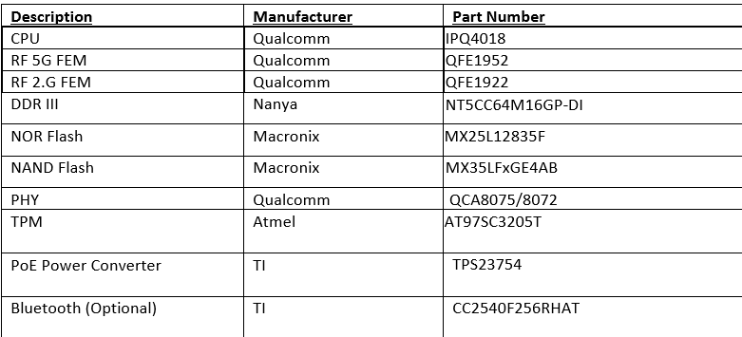
ECW5211 Overview
The ECW5211 is an indoor 802.11 a/b/g/n/ac Wave 2 2x2 dual-band, dual-radio Enterprise Access Point
6 Layer PCB major components

Slide 6
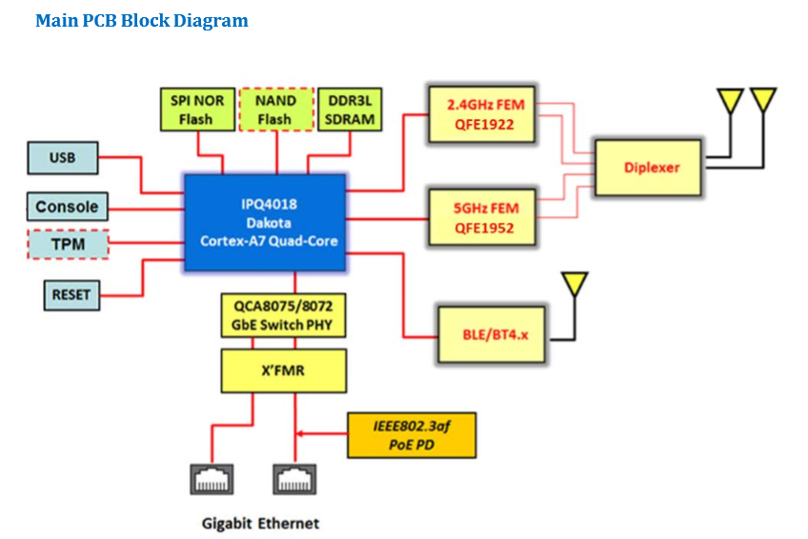
ECW 5211 Functional Overview

Slide 7
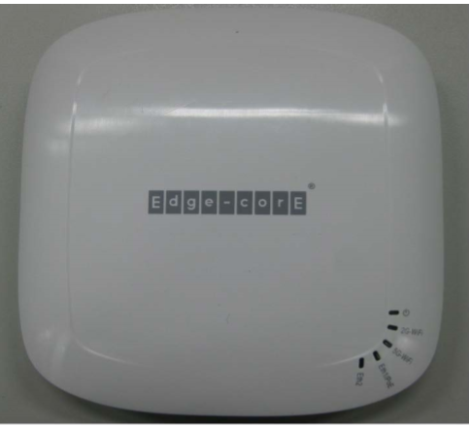
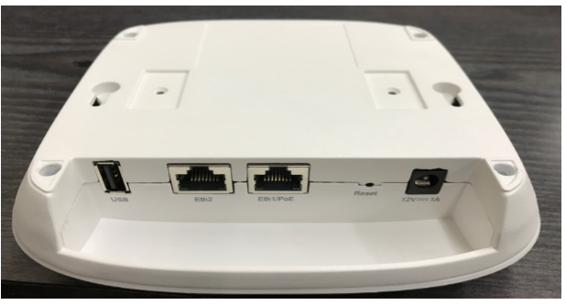
ECW5211 Physical Overview

Slide 8
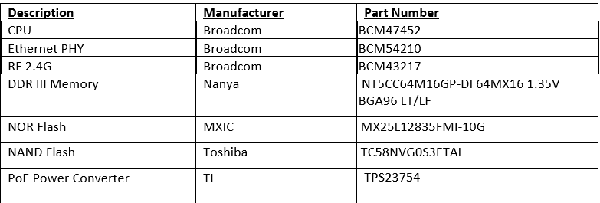
ECW7212 Overview
The ECW7212-L is an indoor 802.11a/b/g/n/ac dual-band, dual-radio enterprise Access Point with a 2x2 MIMO antenna configuration
4 Layer PCB major components

Slide 9
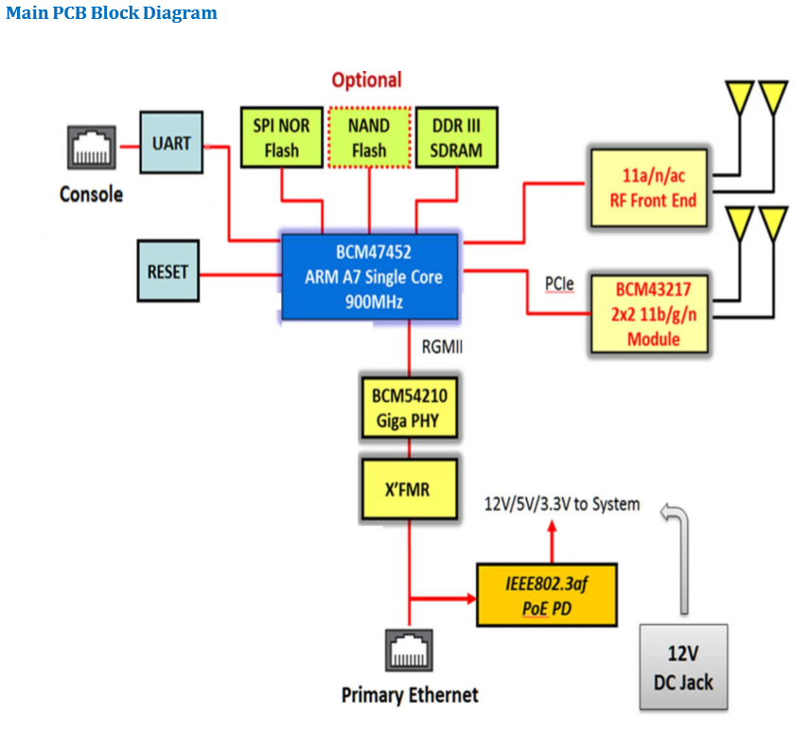
ECW 7212 Functional Overview

Slide 10
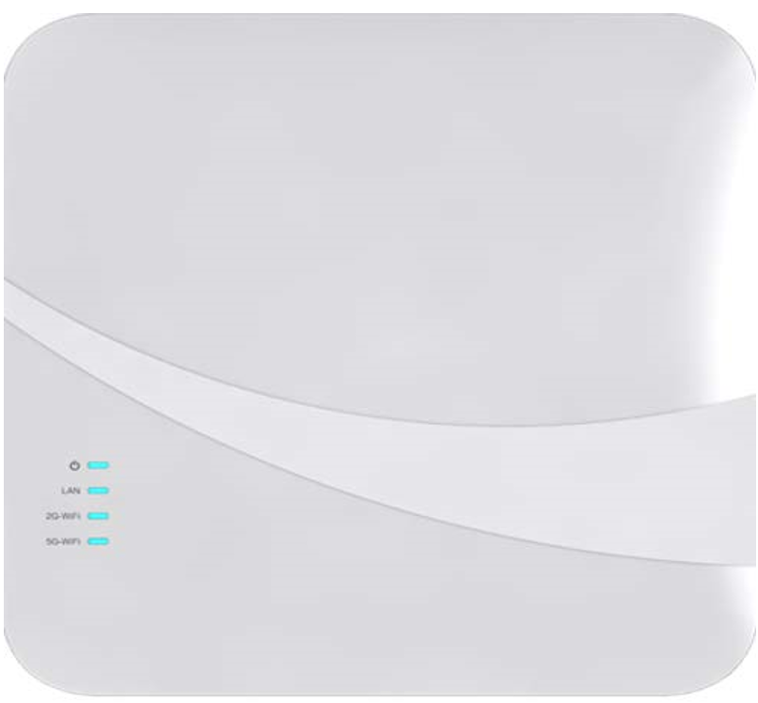
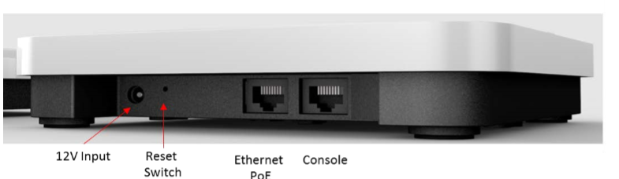
ECW7212 Physical Overview

Slide 11
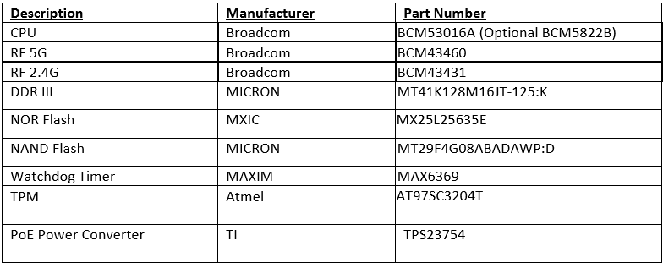
ECW7220 Overview
The ECW7220-L is an indoor 802.11a/b/g/n/ac dual-band, dual-radio enterprise Access Point with a 3x3 MIMO antenna configuration
6 Layer PCB major components

Slide 12
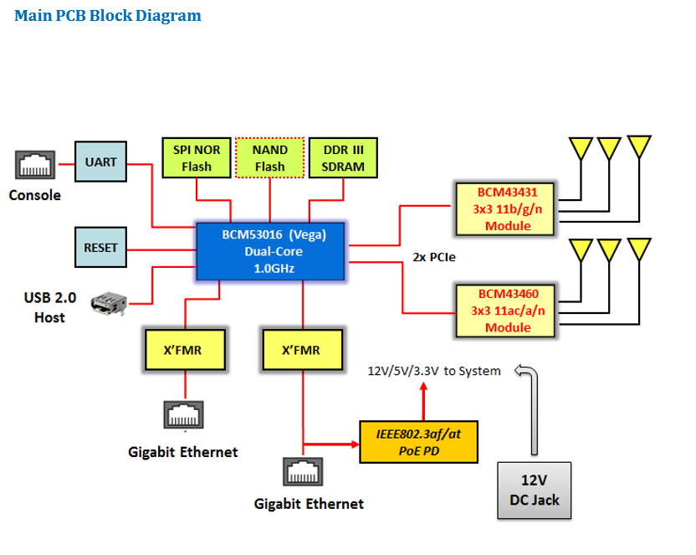
ECW 7220 Functional Overview

Slide 13
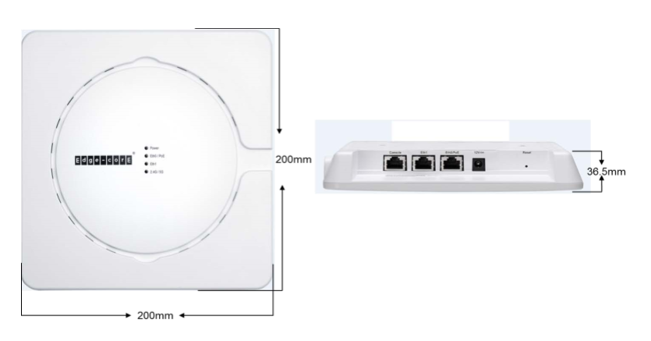
ECW7220 Physical Overview

Slide 14
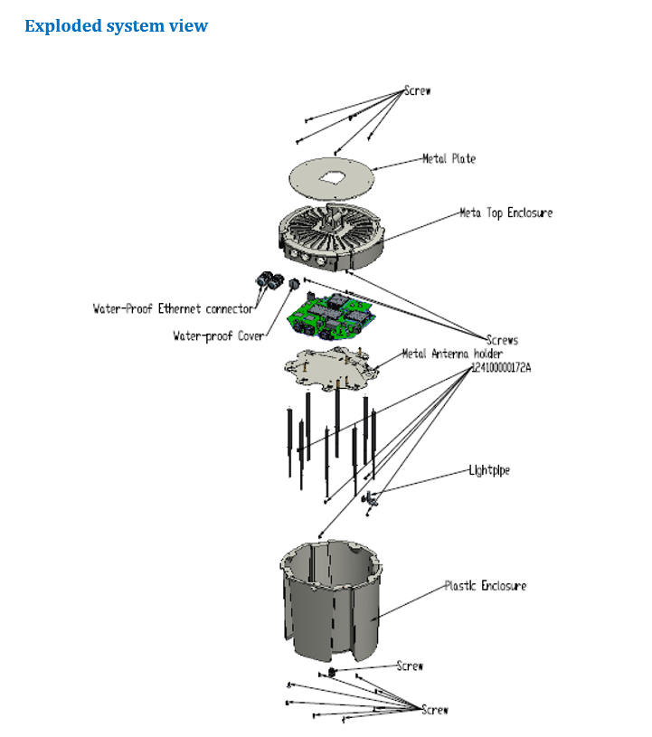
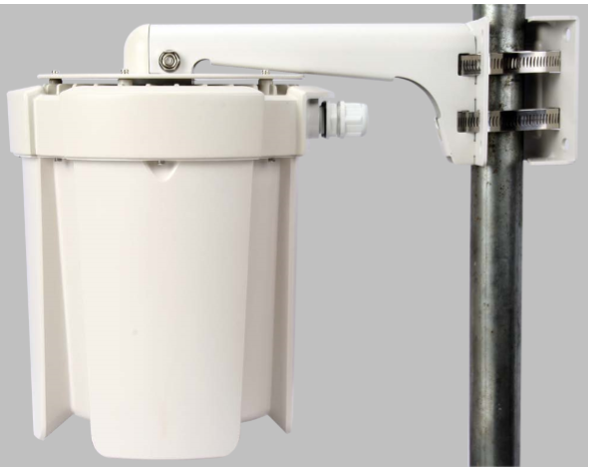
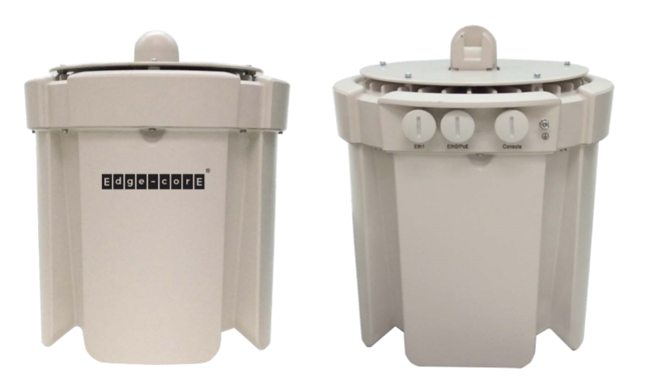
ECWO7220 Physical Overview
IP67 Rated

Slide 15
Thank You

